Slide 1

Cyber Security & Ethical Hacking
Internship Presentation · August–September 2026
Mukesh Bhandari · Roll No. CS-2341752
IILM University, School of Computer Science & Engineering

Slide 2
Internship Overview & Objectives
DOMAIN: CYBERSECURITY & VULNERABILITY ASSESSMENT
1
Fundamentals
Cybersecurity & ethical hacking concepts
2
Kali Linux
Linux commands & security OS
3
Network Scanning
Nmap port & service scanning
4
Vulnerability Assessment
Controlled lab vulnerability analysis
5
Security Research
Threat intelligence & research tools

Slide 3
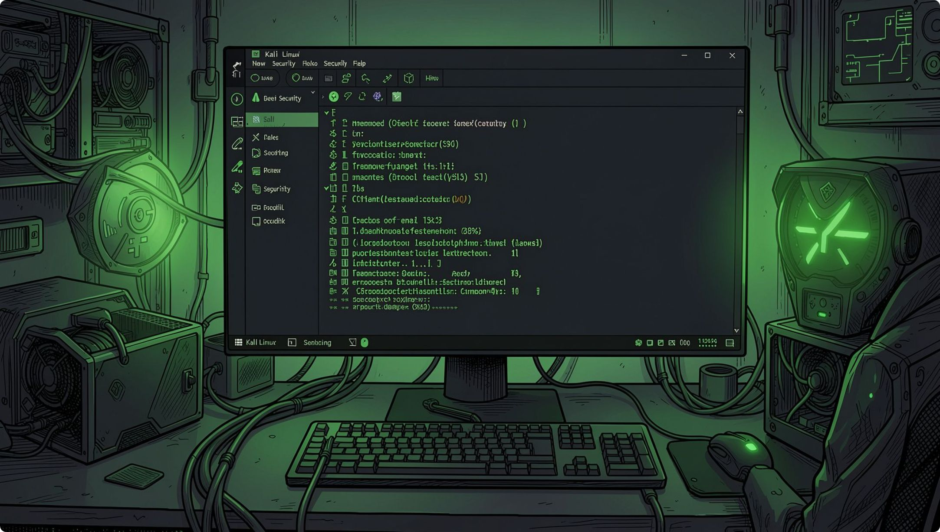
Tools & Technologies
Kali Linux
Security testing OS
VMware
Virtual lab environment
Nmap
Port & service scanning
Metasploitable 2
Vulnerable lab system
VirusTotal
Security analysis
Exploit DB & Shodan
Vulnerability & device research

Slide 4


Methodology & Learning Outcomes
Lab Setup
Nmap Scanning
Provision isolated, authorized environment
Discover hosts and open services
Vuln Assessment
Linux Practice
Hands-on command line and admin tasks
Identify and prioritize security issues
A structured, hands-on approach from environment setup through to professional documentation.
All practical activities were performed in authorized and isolated laboratory environments.

Slide 5




Conclusion & Future Scope
Hands-on exposure to cybersecurity, ethical hacking, and vulnerability assessment — bridging theory and practice.
SOC & SIEM
Operations, log analysis & threat detection
Incident Response
EDR, endpoint security & response
Threat Intelligence
Network monitoring & threat intelligence

